Slide 1
Sudoku Solvers
Group 11: Aleks Murauskas, Erion Hysa, Batin Can Balkan, Nicolas Barreyro Lopez

Slide 2
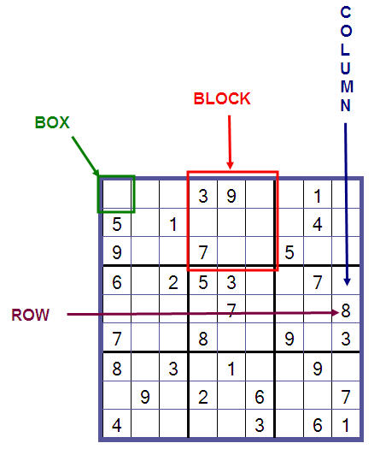
Rules of Sudoku
Each Cell must hold a value between 1 and 9
Each Row, Column and Block can have no repeating values
The Solving of a Sudoku Puzzle is NP Complete, there is no P-time algorithm
The smallest number of clues is 17
6.671×10^21 possible Sudoku puzzles
We will compare two algorithms and how well they can be parallelized

Slide 3
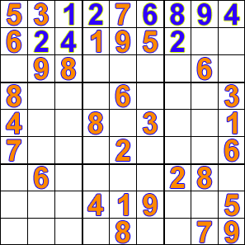
Sequential Brute Force Solution Algorithm
Insert a value into the next empty space (1-9)
Check if it is valid
If it is, continue to the next space and repeat step 1
If not, check if a valid guess has been found earlier this run
If yes, reset the board and add to a queue to restart from one position back, with value +1
If not, end the algorithm, and pull from queue
When queue is empty, the board is solved

Slide 4
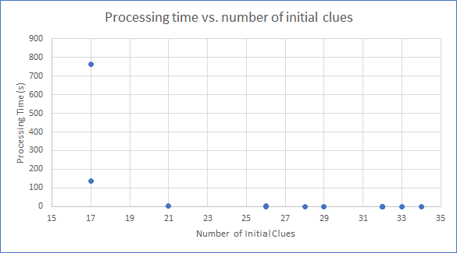
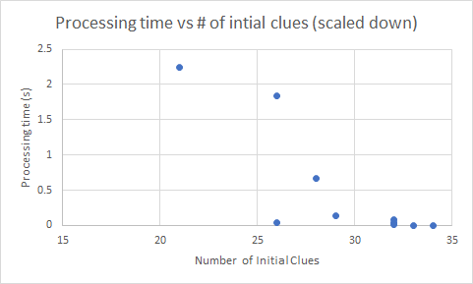
Results
Execution time ignored the perceived difficulty of the board
After running our sequential program we found that the processing time scaled heavily with the number of initial knowns
If the board has a solution, brute force will always find it.
The hardest possible puzzle took over 12 minutes to solve

Slide 5
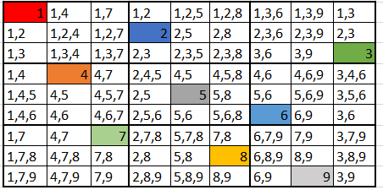
Parallel Brute Force Solution Algorithm
Some overhead, at least one input per thread must be entered into the queue in order to have all working simultaneously
If we check validity on a value is in flux, the validity check fails to be accurate
A race condition is discovered
To solve this, we introduce locks
Each Row, Column, and Block must be locked if a thread is using it
Before acting on a cell, the algorithm checks if it is locked, if locked it is added to the queue and acts on the next cell
Therefore, in our algorithm will not scale beyond 9 threads

Slide 6
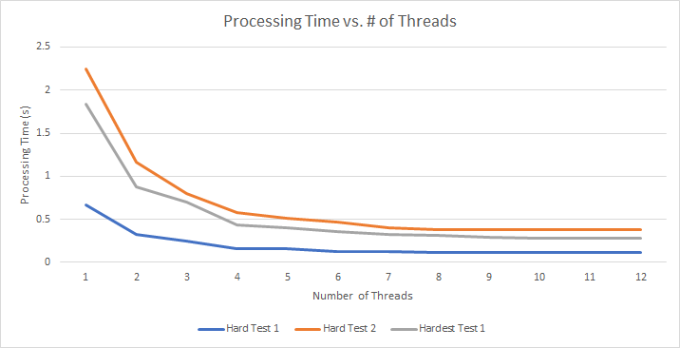
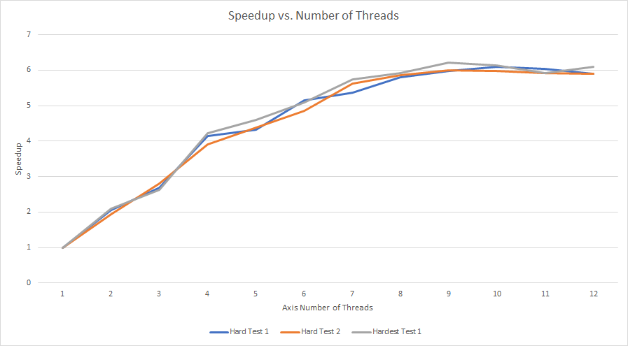
Results
Based on our tests, our Brute Force Algorithm appears to scale exponentially
Beyond 9 threads, we no longer significantly achieve speedup
This is due to avoiding the race condition.
We achieve a maximum speedup of about 6
If we were to increase the number of threads beyond this, there would an abundance of threads waiting

Slide 7
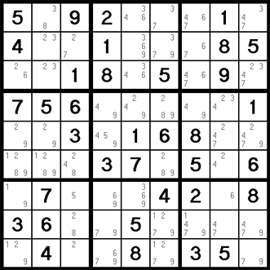
Crook’s Algorithm Sequential
The Crook’s Algorithm is more akin to how a human would solve a Sudoku
The algorithm tracks what the possible values are for each cell, then solves by process of elimination.
It is possible for this algorithm to not be able to find a solution
Update Cells with all possible values
Solve cells that only have one possible value x
Solve cells that are the only member in the set that can hold x
If a step successfully solves a cell, update the board and start again

Slide 8
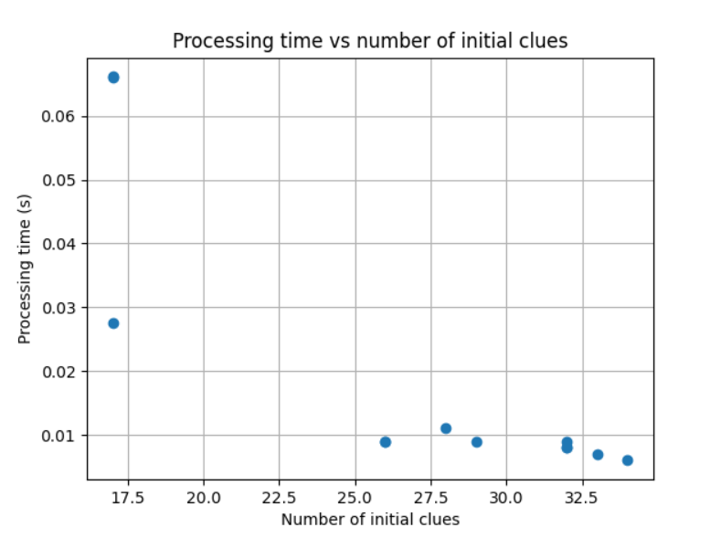
Crook’s Algorithm Results
Crook’s algorithm achieves a significantly faster processing time
Crook’s Algorithm scales with number of clues as well
However, It is possible for Crook’s algorithm to encounter a puzzle where it cannot find a solution

Slide 9
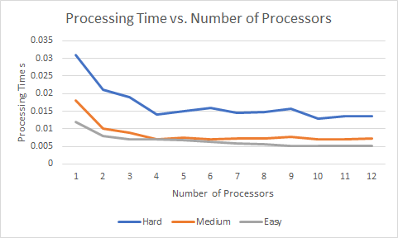
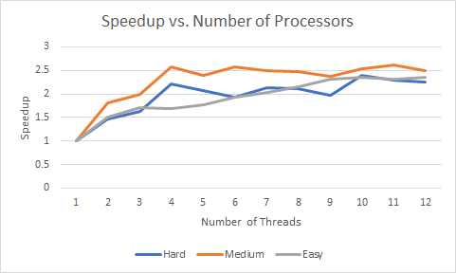
Crook’s Parallel Results
Crook’s algorithm achieves a smaller base processing time, but does not scale as well as our brute force algorithm
As Crook’s operates by process of elimination, it relies on updating the board with new constraints. It is rare for more than one or two new cells to be solved each board update.
Our speed up is about 2.5

Slide 10
Conclusions
Crook’s Algorithm is faster than our Brute Force Algorithm
However, Crook’s algorithm may not solve all possible Sudoku Boards
Ideal Algorithm as follows:
Feed Puzzle into Crook’s Algorithm
If Crook’s Solves Puzzle: Print Solution Board.
Else: Feed Crook’s unfinished Solution into Brute Force
If Brute Force Finds a Solution: Print Solution Board
Else: Puzzle is unsolvable

